Slide 1
IS609 Group Project
Brian Chu, Aaron Palumbo, James Quacinella

Slide 2
Game theory
Tennis ‘duel’ between server and returner
Total conflict:
Only one player wins the point at the expense of the other
Mixed strategy:
Server can serve to the left, right, or center
Returner can guess to each direction too
Assume no pure/dominant strategy

Slide 3
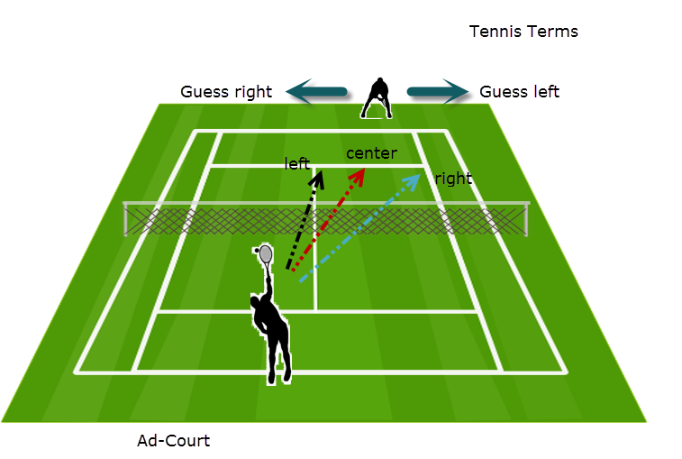
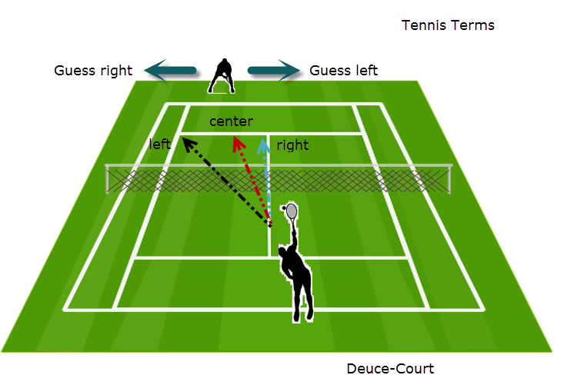
Definition of Terms
NOTICE: Serve right, Guess left means the receiver guessed correctly! This is confusing!

Slide 4
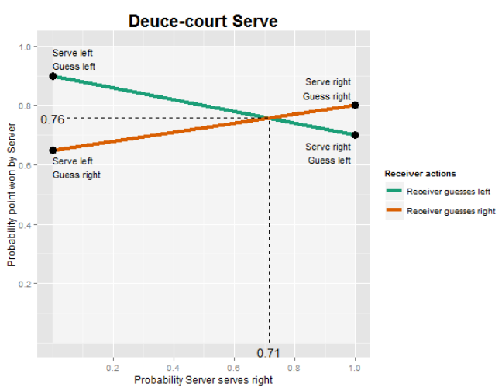
How to detect equilibrium play?
From game theory, we expect to see this, but we cannot detect whether the receiver is guessing left or right, so how do we determine if they are playing in equilibrium?

Slide 5
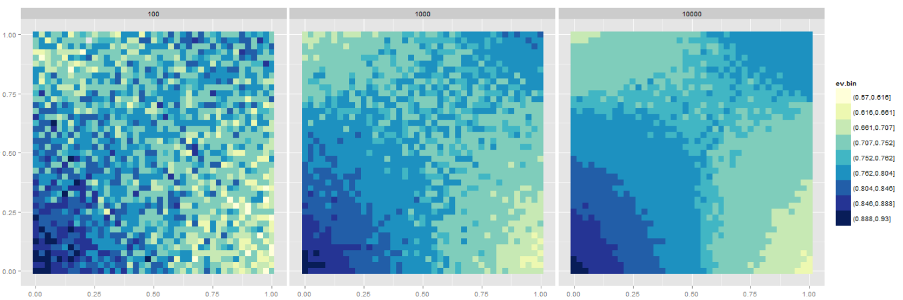
Simulated Game space
Times simulated
Probability Serve Right
Probability Receiver Guesses Right
Each square is run through the simulation the indicated number of times. We can see the equilibrium play at server=0.71 and receiver=0.58. We also see the need to have many games.

Slide 6
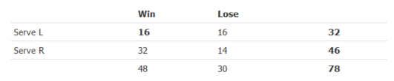
Chi squared
Estimate of Independence
Hypothesis: When play is in equilibrium, the chi squared statistic will be low, indicating that serving left or right is independent of winning or losing the point.

Slide 7
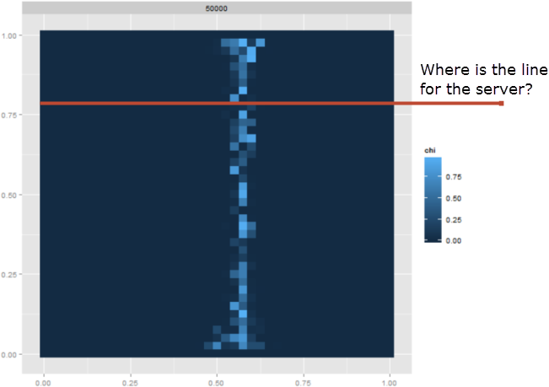
Chi Squared Over Game Space

Slide 8
Dataset
Specific match data > career/aggregated data
Choose scenario where optimization may be more likely:
High stakes match
Higher ranked players
Players very familiar with each other
Longer match (i.e. more service games played)
Pete Sampras vs. Andre Agassi
Longtime rivals
2001 US Open quarterfinal
Score: 6-7, 7-6, 7-6, 7-6
No service breaks the whole match

Slide 9
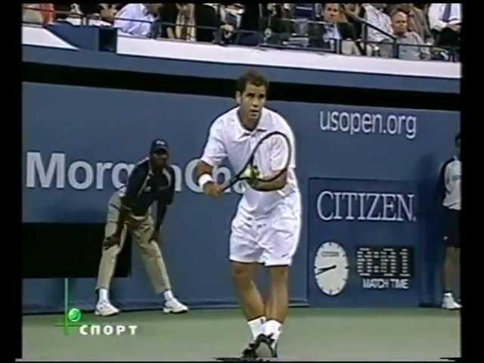
Agassi vs Sampras 2001 QF US Open: https://www.youtube.com/watch?v=ek3CqpKQo74#t=5m39s (Вадим Чижов)
Notes:
5:39 mark

Slide 10
Data variables
Distinguish between 1st/2nd serve
470 total serves (352 1st serves,118 2nd serves)
Distinguish between deuce/ad court service points for each player
Sampras: 240 points (Deuce:130, Ad: 110)
Agassi: 230 points (Deuce: 123, Ad: 107)
Record serves to the left (forehand) and right (backhand)
Center serves ignored (only ~1.5% of total)
Record points won/lost after serving to each side
Calculate percentage of points won on each side
Compare using chi-square statistic and p-value (Walker and Wooders, 2000)

Slide 11
Sampras
Deuce Court
Ad Court
Serve | %Win Left | %Win Right | Chi-sq | p-val
1 | 82.1 | 74.1 | 0.158 | 0.691
2 | 76.9 | 73.3 | 0 | 1
Both | 80.5 | 73.8 | 0.214 | 0.644
Serve | %Win Left | %Win Right | Chi-sq | p-val
1 | 75.0 | 85.2 | 0.253 | 0.615
2 | 58.8 | 71.4 | 0.013 | 0.908
Both | 67.6 | 82.4 | 1.34 | 0.247

Slide 12
Agassi
Deuce Court
Ad Court
Serve | %Win Left | %Win Right | Chi-sq | p-val
1 | 70.0 | 83.3 | 0.681 | 0.409
2 | 80.0 | 54.5 | 0.293 | 0.588
Both | 72.0 | 72.4 | 0 | 1
Serve | %Win Left | %Win Right | Chi-sq | p-val
1 | 90.9 | 68.9 | 1.207 | 0.272
2 | 40.0 | 50.0 | 0.000 | 1.000
Both | 75.0 | 64.4 | 0.248 | 0.618

Slide 13
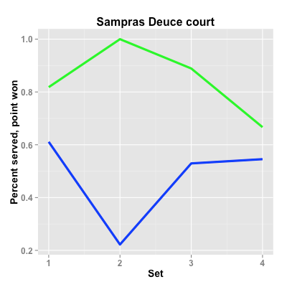
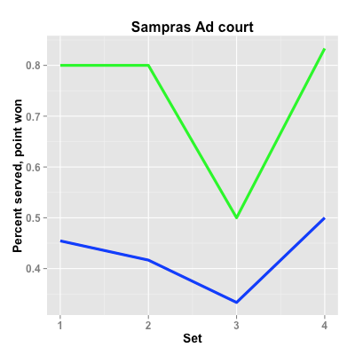

Slide 14
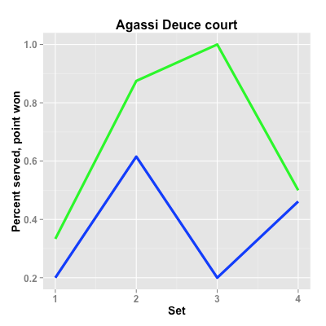
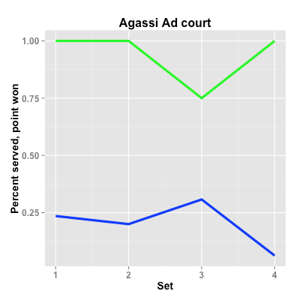

Slide 15
Conclusions
Some evidence of:
Mixed strategy optimization
Optimal mix varies as match goes on
Model limitations:
Limited data set compared to simulation results
Cannot record where returner is guessing
Points won not perfectly correlated with serve direction accuracy

Slide 16
Graph Theory
For this portion of the project, we will see how can we use graph theory to model social networks?
For this project, we looked into how we can model aspects of Twitter
See if we can gain insights into the data science community on Twitter

Slide 17
Summary
We will show nodes can represent users and edges represent follow relationships. This basic model can describe the structure of relationships, but we can expand it even further.
This would require us to create a graph where we have different kinds of nodes and different kinds of edges.
We will also show how to download data from twitter via the API and to come up with a graph visualization.

Slide 18
Twitter?
Twitter is an online social networking service that enables users to send and read short 140-character messages called "tweets". Users connect to one another by 'following' one another, which allows you to see a stream of tweets from them. We will use graph theory to help model the relationships between people on Twitter.

Slide 19
Modeling Follow Relationships
The graph model will have nodes representing users, and edges representing a follow relationship. Code snippet:
import networkx as nx
g = nx.Graph()
g.add_node(0, {"handle": "@mrquntopolous"})
g.add_node(1, {"handle": "@SebastianThrun"})
g.add_edge(0, 1)
node_labels = nx.get_node_attributes(g,'handle')
plt.figure(figsize=(6,6))
pos = nx.spring_layout(g)
nx.draw(g, pos, arrows=True, node_size=900)
nx.draw_networkx_labels(g, pos, labels = node_labels)

Slide 20
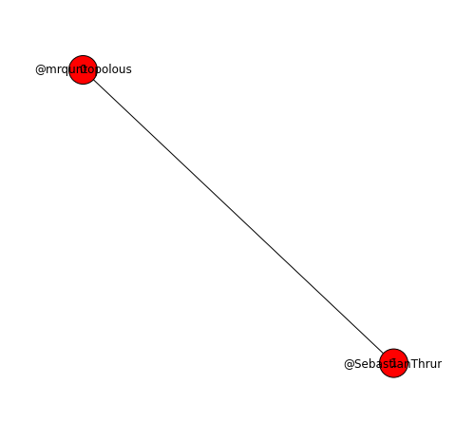
Graph 1

Slide 21
Not Enough!
But, the edge seems ambiguous! Who is following who? Lets add directionality to the edge!
g = nx.DiGraph()
g.add_node(0, {"handle": "@mrquntopolous"})
g.add_node(1, {"handle": "@SebastianThrun"})
g.add_edge(0, 1)
node_labels = nx.get_node_attributes(g,'handle')
plt.figure(figsize=(6,6))
pos = nx.spring_layout(g)
nx.draw(g, pos, arrows=True, node_size=900)
nx.draw_networkx_labels(g, pos, labels = node_labels)

Slide 22
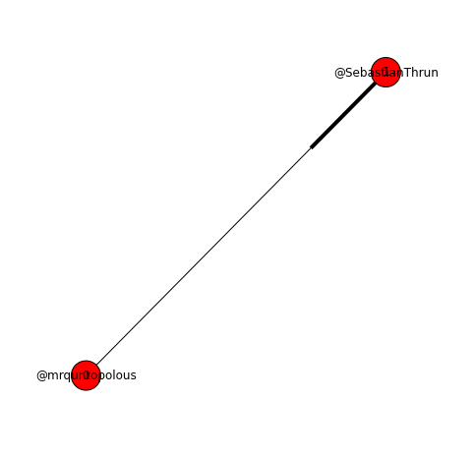
Graph 2

Slide 23
Extending the model
What if we need to model the tweets that user send out themselves, and how users interact with them? In the graph models we have used prior, typically a node represented one kind of thing. However, the previous nodes represented users, so how will we model tweets or other entities?
Using a property graph, we can add properties to nodes and edges, which can help us differentiate between different kinds of entities and relationships in our graphs.
For example, we can add a node that represents a tweet made by one of these users. We will color it differently to emphasize that its a different kind of node.

Slide 24
Sample code
g = nx.DiGraph()
g.add_node(0, {"id": "@mrquntopolous", "color": "r"})
g.add_node(1, {"id": "@SebastianThrun", "color": "r"})
g.add_node(2, {"id": "Tweet #530038648860065793", "color": "orange"})
g.add_edge(0, 1, {"type": "follows"})
g.add_edge(0, 2, {"type": "tweeted"})
node_labels = nx.get_node_attributes(g,'id')
edge_labels = nx.get_edge_attributes(g,'type')
colors = nx.get_node_attributes(g, 'color')
plt.figure(figsize=(6,6))
pos = nx.spring_layout(g)
nx.draw(g, pos, arrows=True, node_size=900, node_color=colors.values())
nx.draw_networkx_labels(g, pos, labels = node_labels)
nx.draw_networkx_edge_labels(g, pos, labels = edge_labels)

Slide 25
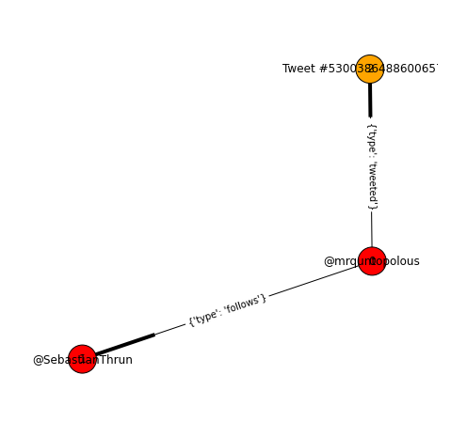
Graph 3

Slide 26
Twitter API
Twitter has an official API that allows users to query their service for data. The only thing you need is a developer account with proper OAuth keys.
In the following example, we use the GetUser() API call from Twitter, which returns a response in JSON.

Slide 27
Sample Twitter code
import twitter
from config import *
import pickle
import pprint
import json
# Create Twitter API object
api = twitter.Api(consumer_key=CONSUMER_KEY, consumer_secret=CONSUMER_SECRET,
access_token_key=ACCESS_TOKEN_KEY,access_token_secret=ACCESS_TOKEN_SECRET)
# Print
hmason_json = api.GetUser(screen_name='hmason')
pprint.pprint(json.loads(str(hmason_json)))

Slide 28
Sample JSON for User
{u'created_at': u'Sun Feb 11 21:22:24 +0000 2007', u'description': u'Founder at @FastForwardLabs. Data Scientist in Residence at @accel. I \u2665 data and cheeseburgers.', u'favourites_count': 3549, u'followers_count': 50613, u'friends_count': 1204, u'id': 765548, u'lang': u'en', u'listed_count': 3290, u'location': u'NYC', u'name': u'Hilary Mason', u'profile_background_color': u'000000', u'profile_background_tile': False, u'profile_image_url': u'https://pbs.twimg.com/profile_images/1290564266/me_square_normal.jpg', u'profile_link_color': u'282F8A', u'profile_sidebar_fill_color': u'http://pbs.twimg.com/profile_background_images/73787182/background_steampunk_smaller.jpg', u'profile_text_color': u'000000', u'protected': False, u'screen_name': u'hmason', …
u'statuses_count': 13647, u'time_zone': u'Eastern Time (US & Canada)', u'url': u'http://t.co/ijjKDNIVOE', u'utc_offset': -18000}

Slide 29
Crawling Twitter
For the project, we decided to map out the Data Science community on twitter. The plan is to construct a graph where nodes represent users and edges represent a follow relationship.
We did this by starting with some known people in the Data Science world, like Hilary Mason, which we call seed nodes. We then used the Twitter API to find who follows these known people. These people are known as being one degree of separation away from the seed nodes. We also took these users and found out who they follow as well, getting us new nodes that are two degrees of separation.
Issues
Twitter's API has a limitation on the number of API calls that can be made, so crawling is slow
Need good error handling and backoff logic to handle errors from Twitter's API

Slide 30
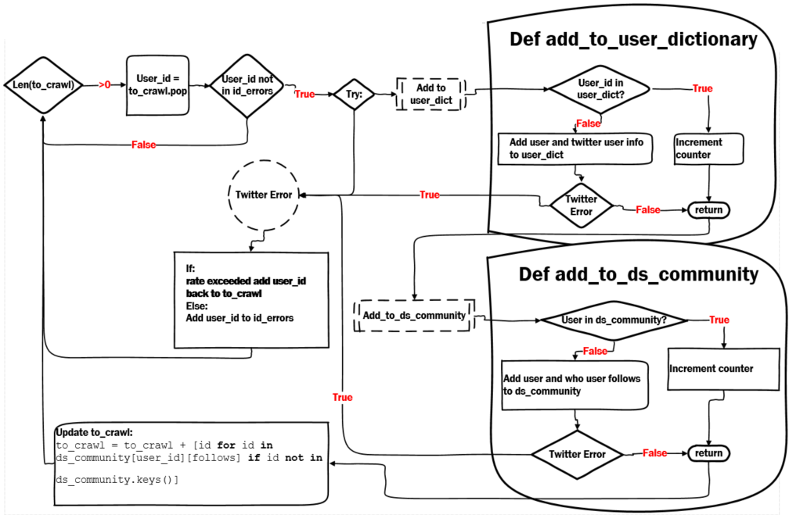
Details of Crawl

Slide 31
Building A Graph From Crawl Results
Given that objects created by the crawl, we can now use them to create a NetworkX graph. Below is a snippet of code that builds the graph from our crawl results (network_graph.py, function graph_construction):

Slide 32
Code Snippet: Building Graph
# Initialize directed graph
g = nx.DiGraph()
# Filter out nodes that have low counts
user_dict_filtered = {}
for uid in user_dict:
if user_dict[uid]['count'] >= 2:
user_dict_filtered[uid] = user_dict[uid]
uids_in_graph = user_dict_filtered.keys()
# Add nodes to graph
for uid in uids_in_graph:
g.add_node(uid, {'handle': user_dict_filtered[uid]['name']})
# Add edges to graph
for uid in uids_in_graph:
follows_in_graph = [i for i in graph_info[uid]['follows'] if i in uids_in_graph]
for i in follows_in_graph:
g.add_edge(uid, i, color='blue')

Slide 33
Displaying the Graph
There are issues with displaying large graphs like this:
Too many nodes to see details correctly
Too many edges overlapping
Solution is to :
trim the graph as best you can
layout the nodes using NetworkX’s positioning features

Slide 34
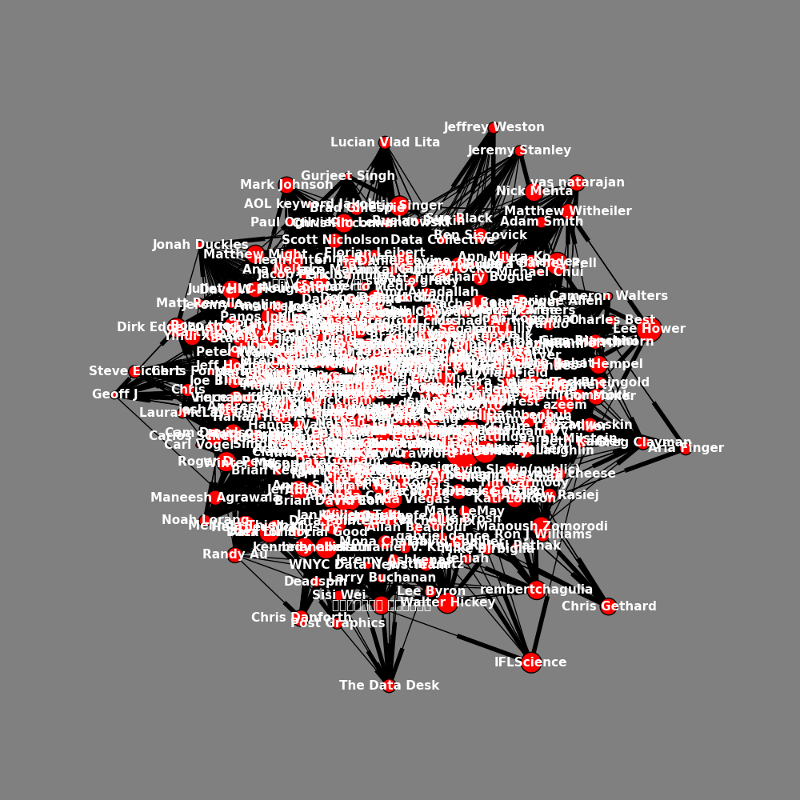

Slide 35
Yikes!
Not very informative! It would be great to organize the graph based on which nodes are ‘more central’ or ‘important’ to the structure of the graph. Is there any way to measure this property on nodes?

Slide 36
Graph Centrality
In graph theory, centrality refers to various metrics which identify which of the vertices within a graph are the most important. For our purposes, we would like to identify the most influential people in the data science community that we crawled. There are many different ways of defining centrality, including:
Degree Centrality - One metric that can help define which vertices are important is using the number of links incident upon a node. The more edges on a node, the more 'important' it might be. This is one the simplest metrics for centrality.
Closeness Centrality - In graph theory, the shortest path is the minimal amount of hops needed to travel between two nodes. We define another distance metric that is defined as the sum of its shortest path distances to all other nodes. The smaller the number, the closer this node is to all other nodes, so we can define closeness as the reciprocal of this metric. We will not use this metric.
Betweenness Centrality - this metric quantifies the number of times a node acts as a 'bridge' along the shortest path between two other nodes. The more often a node is along shortest path in the graph, the more likely it is to be important. Notice how both closeness and betweenness are defined in terms of the whole graph, while degree centrality is defined locally per node.
PageRank - is an iterative algorithm that outputs a probability distribution over nodes that represents the likelihood that a person randomly moving along edges will arrive at any particular node. After each iteration, the node's value is an approximate PageRank value that approaches the theoretical true value over time.

Slide 37
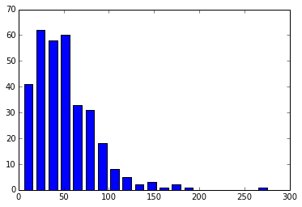
Degree Centrality
Lets look at our crawled graph and see if we can find nodes with a high number of edges coming in. Using networkx's in_degree() function, we can look at a histogram of in-degree values. Notice the long tail of nodes with large number of incoming edges.

Slide 38
Lets Try Visualizing Again
We can use this information to organize nodes into layers, based on their in-degree. The results are a lot more readable:

Slide 39
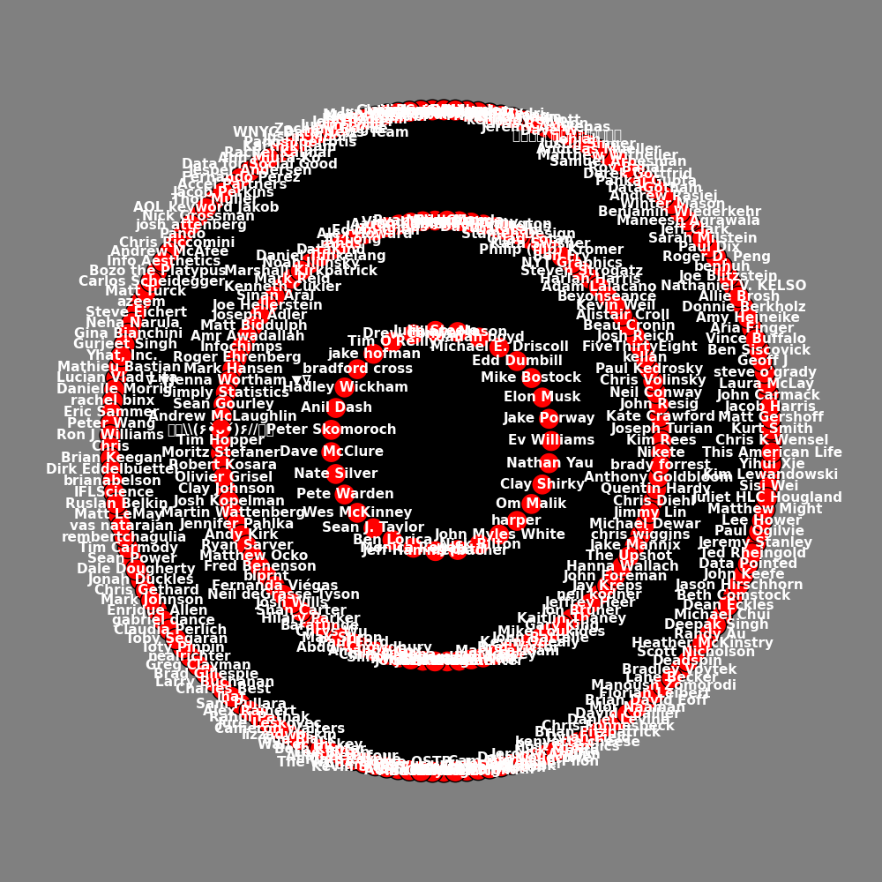

Slide 40
Any Useful Information?
Ev Williams, co-founder of twitter
Jake Porway, Founder and Executive Director @ DataKind
Elon Musk, Not really in DS community but in broader tech community
Edd Dumbill, VP Strategy at Silicon Valley Data Science
Michael E. Driscoll, Founder + CEO @Metamarkets; data; analytics; visualization
danah boyd, Microsoft Researcher; focuses on people's everyday practices involving social media
Julie Steele, Director of Communications at Silicon Valley Data Science
Tim O'Reilly, Founder of O'Reilly Media and a supporter of the free / open source movements
jake hofman, research scientist at msr nyc, interested in learning from data.
bradford cross, I’m a founder CEO focused on consumer products, investing, and data technologies.
Anil Dash, CoFounder CEO of ThinkUp, the first analytics tool for social media
Peter Skomoroch, data scientist @ Data Collective
Dave McClure, Entrepreneur and prominent angel investor
Pete Warden, Engineer at Google
Wes McKinney, Author of "Python for Data Analysis"
Sean J. Taylor, Social Scientist. Hacker. Facebook Data Science Team
Ben Lorica, Chief Data Scientist at O'Reilly Media, Inc
Monica Rogati, Data scientist with a passion for turning data into products
Jeff Hammerbacher, Founder and Chief Scientist of Cloudera
Nick Bilton, Journalist and author; formerly lead blogger for the New York Times' bits blog
John Myles White, Authors of Machine Learning for Hackers
harper, Former CTO @ Obama for America; founder of Modest
Om Malik, Web and technology writer; founder of and senior writer for GigaOM.
Clay Shirky, Writer on the social and economic effects of Internet technologies
Nathan Yau, Owner of FlowingData. Author of Visualize This

Slide 41
Summary of Central Nodes
The vast majority of them seem to be good candidates for being in the Data Science community.
Notice that some users are not really in the data science community, like Clay Shirky, Dave McClure and Elon Musk. This highlights another aspect of graph theory, and that is of communities and community detection. Communities are groups of nodes in a graph that are highly connected, indicated that they 'belong' together for some reason.
For example, we have tried to crawl some part of the data science community with our crawl above. However, in graphs, communities can overlap, where nodes can belong to more than one group. In this case, Elon Musk is followed by a lot of people in the DS community, even though one wouldn't consider him to be a member.

Slide 42
Modeling ‘Reach’ and ‘Influence’
Another common thing to do with social networks is to measure how influential a user is. One metric to help determine this is the idea of reach, or how many people see you social media messages that you post.
As an example, we can create a graph model of a tweet, the users who retweeted it, and the number of followers those users have. This gives us an upper bound on the number of people who saw a tweet in their stream.
Here is a very small snippet of a graph built from an example tweet from Hilary Mason

Slide 43
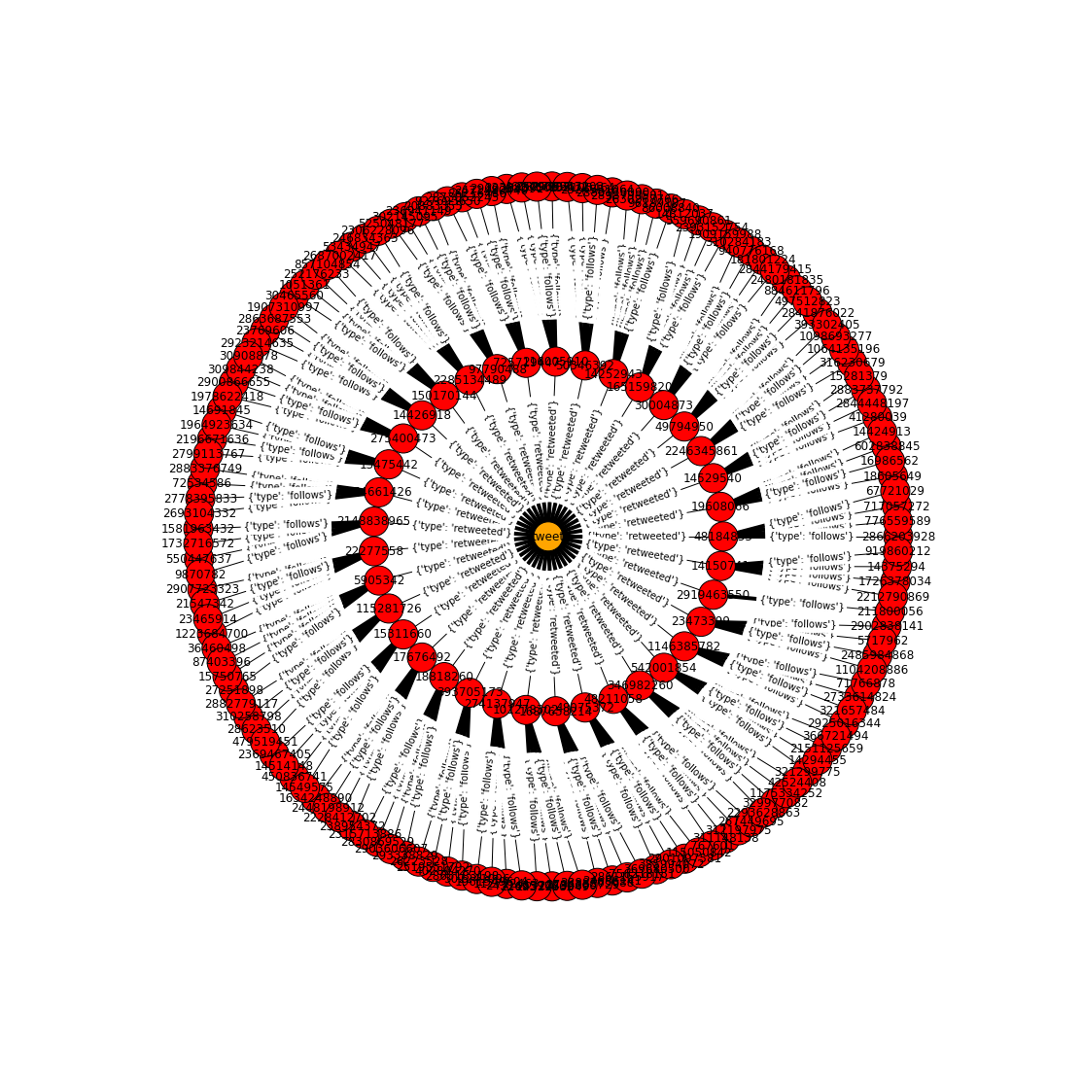

Slide 44
Measure Reach?
The ‘reach’ therefore would be the sum of the number of incident links on the user nodes who retweeted this tweet. We can then measure this for all tweets from a user, to get an average ‘reach’ measurement for a user.

Slide 45
Questions?

